Slide 1

RAJKIYA ENGINEERING COLLEGE BIJNOR
Submitted to: Submitted By:
Mr. Santosh Kumar Kumar Shanu
IT Department 1773513025
Notes:
ai
<number>

Slide 2
Cloud Computing
Cloud Computing
With
With
AWS
AWS

Slide 3
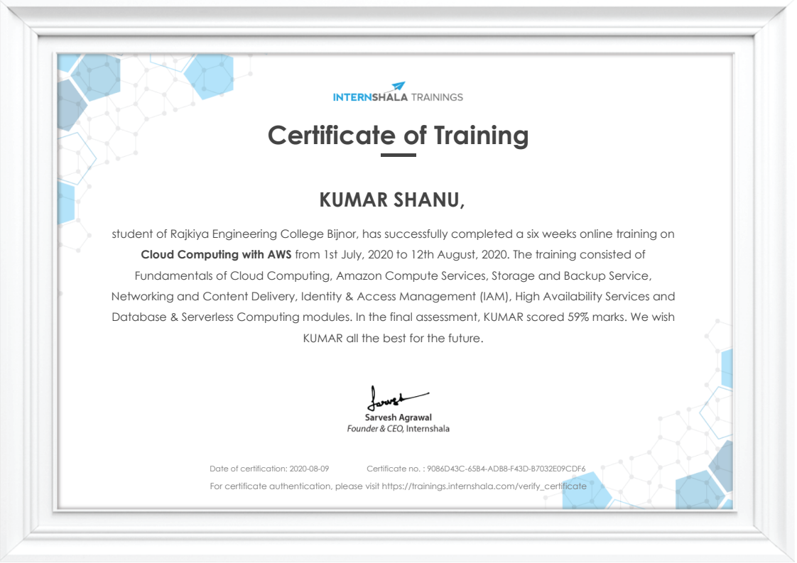
Certificate of Training

Slide 4
INTRODUCTION
INTRODUCTION
Cloud Computing provides us a means by which
we can access the applications as utilities, over
the Internet. It allows us to create, configure, and
customize applications online.
With Cloud Computing users can access database
resources via the internet from anywhere for as
long as they need without worrying about any
maintenance or management of actual resources.

Slide 5
What is Cloud?
What is Cloud?
The term Cloud refers to a Network or Internet.
In other words, we can say that Cloud is something,
which is present at remote location.
Cloud can provide services over network, i.e.,
on public networks or on private networks, i.e.,
WAN, LAN or VPN.
Applications such as e-mail, web conferencing,
customer relationship management (CRM),
all run in cloud.

Slide 6
What is Cloud Computing?
What is Cloud Computing?
Cloud Computing refers to manipulating,
configuring, and accessing the applications online.
It offers online data storage, infrastructure and application.
Cloud Computing is both a combination of software and
hardware based computing resources delivered as a
network service.

Slide 7
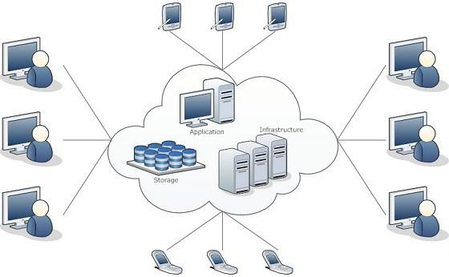
Cloud Computing Architecture
Cloud Computing Architecture

Slide 8
Basic Concepts
Basic Concepts
There are certain services and models working behind the
scene making the cloud computing feasible and accessible
to end users. Following are the working models for cloud
computing:
1. Deployment Models
1. Deployment Models
2. Service Models
2. Service Models

Slide 9
Deployment Models
Deployment Models
Deployment models define the type of access to the
cloud, i.e., how the cloud is located? Cloud can have any
of the four types of access: Public, Private, Hybrid and
Community.

Slide 10
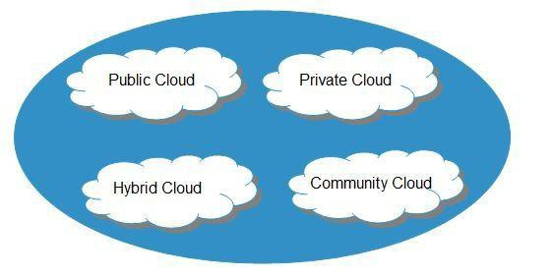

Slide 11
PUBLIC CLOUD
PUBLIC CLOUD
:
The Public Cloud allows systems and services to be
easily accessible to the general public. Public cloud may be less secure because
of its openness, e.g., e-mail.
PRIVATE CLOUD
PRIVATE CLOUD
:
The Private Cloud allows systems and services to be
accessible within an organization. It offers increased security because of its
private nature.
COMMUNITY CLOUD
COMMUNITY CLOUD
:
The Community Cloud allows systems and
services to be accessible by group of organizations.
HYBRID CLOUD
HYBRID CLOUD
:
The Hybrid Cloud is mixture of public and private
cloud. However, the critical activities are performed using private cloud while
the non-critical activities are performed using public cloud.

Slide 12
Service Models
Service Models
Service Models are the reference models on which the
Cloud Computing is based. These can be categorized
into three basic service models as listed below
:

Slide 13
1.
Infrastructure as a Service (IaaS)
1.
Infrastructure as a Service (IaaS)
2. Platform as a Service (PaaS)
2. Platform as a Service (PaaS)
3. Software as a Service (SaaS)
3. Software as a Service (SaaS)

Slide 14
Infrastructure as a Service (IaaS)
Infrastructure as a Service (IaaS)
IaaS is the delivery of technology infrastructure as an on
demand scalable service.
IaaS provides access to fundamental resources such as
physical machines, virtual machines, virtual storage, etc.
•
Usually billed based on usage
•
Usually multi tenant virtualized environment
•
Can be coupled with Managed Services for OS and
application support

Slide 15






IaaS Examples
IaaS Examples

Slide 16
Platform as a Service (PaaS)
Platform as a Service (PaaS)
PaaS provides the runtime environment for applications,
development & deployment tools, etc.
PaaS provides all of the facilities required to support the
complete life cycle of building and delivering web
applications and services entirely from the Internet.
Typically applications must be developed with a particular
platform in mind
•
Multi tenant environments
•
Highly scalable multi tier architecture

Slide 17

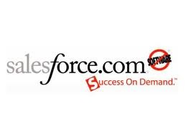
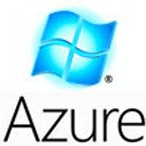



PaaS Examples
PaaS Examples

Slide 18
Software as a Service (SaaS)
Software as a Service (SaaS)
SaaS model allows to use software applications as a service
to end users.
SaaS is a software delivery methodology that provides
licensed multi-tenant access to software and its functions
remotely as a Web-based service.
•
Usually billed based on usage
•
Usually multi tenant environment
•
Highly scalable architecture

Slide 19
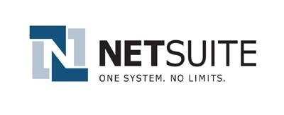
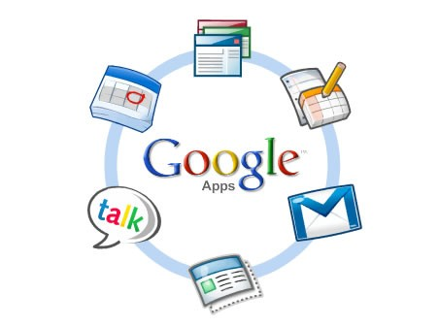

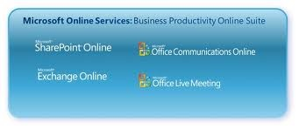

SaaS Examples
SaaS Examples

Slide 20

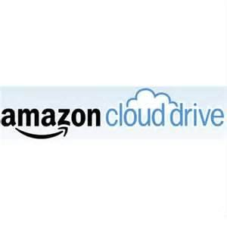



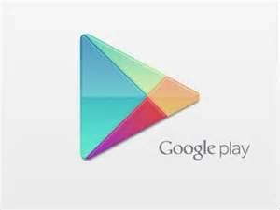

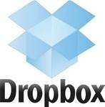








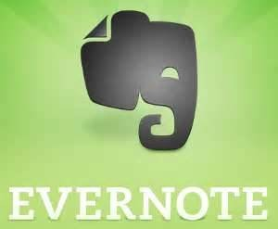





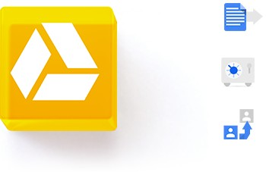
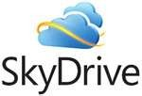


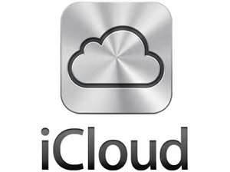








Do you Use the Cloud?
Do you Use the Cloud?

Slide 21
Advantages
Advantages
•
Lower computer costs
•
Improved performance:
•
Reduced software costs
•
Instant software updates
•
Improved document format compatibility
•
Unlimited storage capacity
•
Increased data reliability
•
Universal document access
•
Latest version availability
•
Easier group collaboration
•
Device independence

Slide 22
Disadvantages
Disadvantages
•
Requires a constant Internet connection
•
Does not work well with low-speed connections
•
Features might be limited
•
Can be slow
•
Stored data can be lost
•
Stored data might not be secure

Slide 23
Cloud Storage
Cloud Storage
•
Create an Account
User name and
password.
•
Content lives with the
account in the cloud.
•
Log onto any
computer with Wi-Fi
to find your content

Slide 24

Download For Storage
Download For Storage
•
Download a cloud based app to on your computer
•
The app lives on your Computer
•
Save files to the app
•
When connected to the Internet it will sync with the cloud
•
The Cloud can be accessed from any Internet connection

Slide 25
Thank
Thank
you…
you…
Question…?
Question…?

